Slide 1
CAR Review
Team A:
Mel Fehrenbacher, Matthew Marotto, Barbara Scala

Slide 2
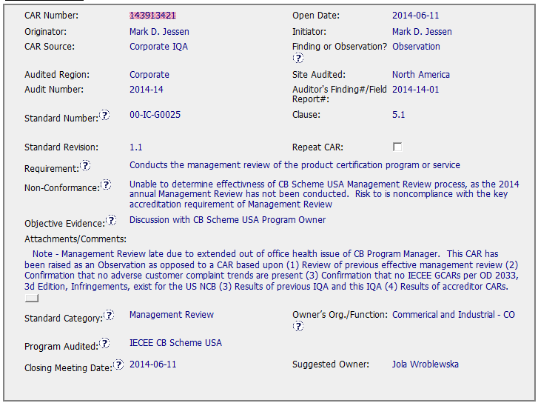
CAR 143913421
Note are clear and useful, but it initials and date should be added.

Slide 3
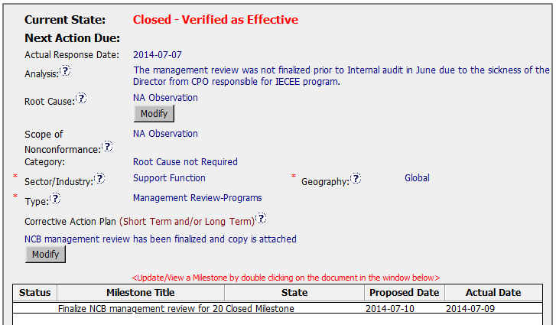
CAR 143913421
As this is an Observation Analysis, Root Cause and Scope of Non conformance should be N.A., but in this case the Owner just included an explanation.

Slide 4
CAR 143913421 - CBS
INTEGRITY: Initiative & Decision Making / Analyzing & Problem Solving
Facilitates progression of the CAR through closure: extensions, escalations, reassignments, etc. (+)
Accurately completes the administrative fields within the CAR such as root cause category, process impacted, geography, etc. (+)
Acts on CARs within the required timeframe (+)
Most appropriate ‘category’, ‘type’, ‘geography’ are selected (+)

Slide 5
CAR 143913421 - CBS
COMPETIVENESS: Customer Focus / Achieve Business Results / Flexibility
Assists customers as they address all aspects of the CAR – analysis, root cause statement, milestone, containment, verification, etc. (+)
Verifies CARs timely (+)
Corrective actions fix the objective evidence and other problems found; address entire root cause and scope. (+)
Milestones address; completed per milestone expectations (+)
Verification per requirements (+)
COLLABORATION: Leading & Engaging / Teamwork / Communication
Provides pertinent feedback at appropriate times; shares information and keeps others informed (+)

